Slide 1
ECONOMICS
Bridge Course​

Slide 2
What Is Economics?
Economics is a social science that focuses on the production, distribution, and consumption of goods and services, and analyzes the choices that individuals, businesses, governments, and nations make to allocate resources.

Slide 3
KEY TAKEAWAYS
Economics is the study of how people allocate scarce resources for production, distribution, and consumption, both individually and collectively.
The two branches of economics are microeconomics and macroeconomics.
Economics focuses on efficiency in production and exchange.
Gross Domestic Product (GDP) and the Consumer Price Index (CPI) are two of the most widely used economic indicators.

Slide 4

DEVELOPMENT
Development is any improvement in the standard of living of people in a specific country.

Slide 5
Indicators of Human Development
Human development index rank
India has been on 130th rank in Human Development Index.
Life expectancy
It is the age by which a particular person belonging to a particular age is expected to live.
Life expectancy at birth in India: Males: 67.34 years , Females: 69.64 years
Infant mortality rate
It is the total number of infants dying below the age of 1 year out of 1000 babies.
Infant mortality rate in India is 40.5 infants.

Slide 6
Maternal mortality rate
It is the total number of dying mothers out of 1000 mothers while giving birth to babies.
According to the 2011–13 census, maternal mortality rate in India is 167 deaths.
Adult literacy ratio
It refers to the number of people of both the sexes, i.e., male and female aging more than 15 years having the ability to read and write.
Percentage of the population below poverty line
People below the poverty line are categorised according to calories consumed by each person per day, which is 2400 in rural areas and 2100 in urban areas.
Any person consuming calories less than the minimum limit mentioned above is said to be below the poverty line.

Slide 7
LITERACY RATE
Literacy rate measures the proportion of literate population in the age group of 7 and above in the total population of the same age group.
Literacy rate is the literate population of the age group 7 years and above divided by the total population of the same age group.

Slide 8
BIRTH RATE
Birth rate, also called natality, is the number of live births per 1000 persons in a year.
It is one of the factors that determine the population growth of a region, along with mortality and migration rate.
Birth rate can be calculated by dividing the total number of offspring born by the total members of the population.

Slide 9
DEATH RATE
Death rate refers to the number of people dying in a year per thousand people.
Also known as ‘mortality’
Contributes to the decrease in population.

Slide 10
GLOBALISATION
Globalisation refers to the integration of the domestic economy with the economies of the world.
`
What is the Full form of MNC?
The full form of MNC is the Multinational Corporation.
Liberalization means the removal of barriers and restrictions set by the government on foreign trade. Governments use trade barriers to increase or decrease (regulate) foreign trade to protect the domestic industries from foreign competition. Example, Tax on imports. Around 1991, government India adopted the policy of liberalization.

Slide 11
What is the Full form of WTO?
World Trade Organization (WTO) was started at the initiative of the developed countries. Its main objective is to liberalize international trade.

Slide 12
What are the sectors of the economy?
Human activities which generate income are known as economic activities. Economic activities are broadly grouped into primary, secondary, tertiary activities. Higher services under tertiary activities are again classified into quaternary and quinary activities.

Slide 13

PRIMARY SECTOR
Primary activities are directly dependent on the environment as these refer to utilisation of earth’s resources such as land, water, vegetation, building materials and minerals. It, thus includes hunting and gathering, pastoral activities, fishing, forestry, agriculture, and mining and quarrying.
People engaged in primary activities are called red-collar workers due to the outdoor nature of their work.

Slide 14
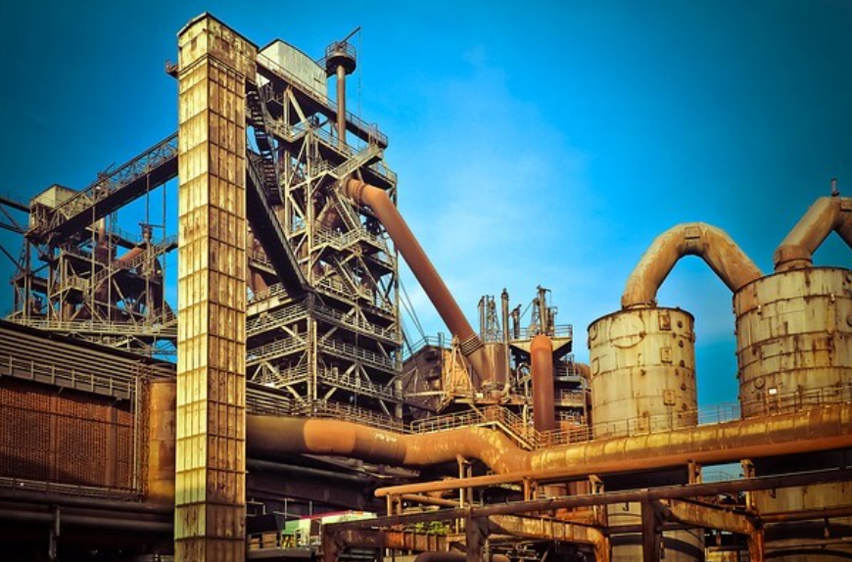
SECONDARY SECTOR
Secondary activities add value to natural resources by transforming raw materials into valuable products. Secondary activities, therefore, are concerned with manufacturing, processing and construction (infrastructure) industries.
People engaged in secondary activities are called blue-collar workers.

Slide 15
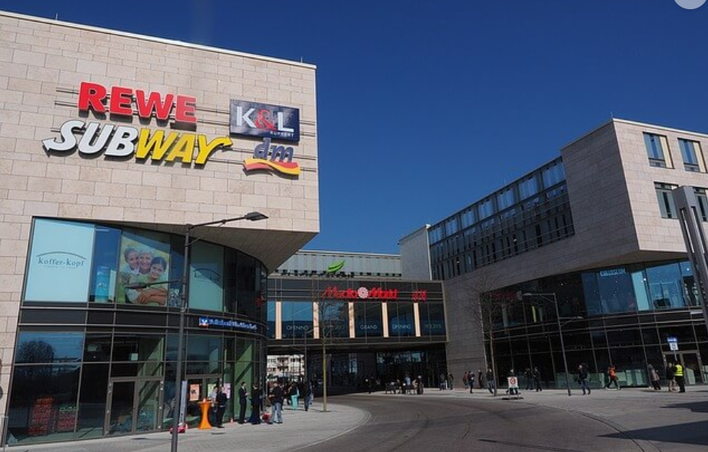
TERTIARY SECTOR
Tertiary activities include both production and exchange. The production involves the ‘provision’ of services that are ‘consumed. Exchange involves trade, transport and communication facilities that are used to overcome distance.
Tertiary jobs = White-collar jobs.

Slide 16
THANK YOU

